Slide 1
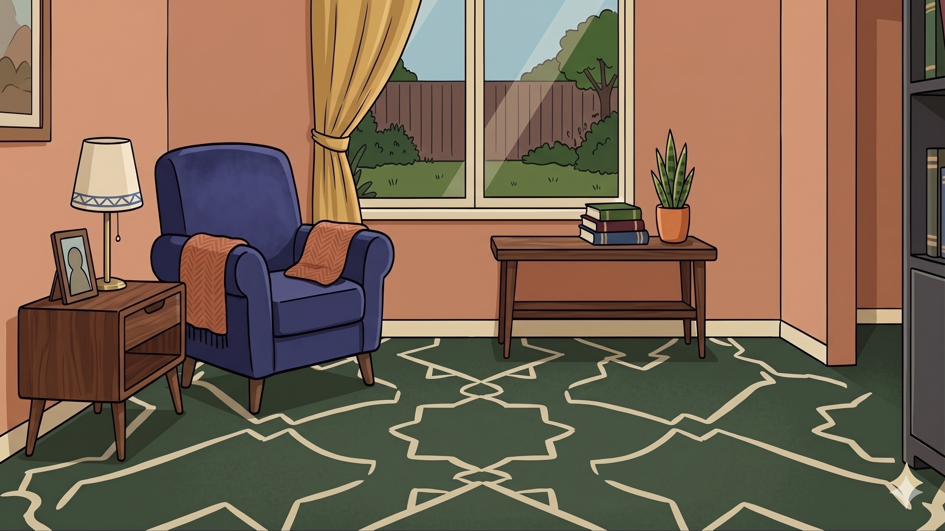
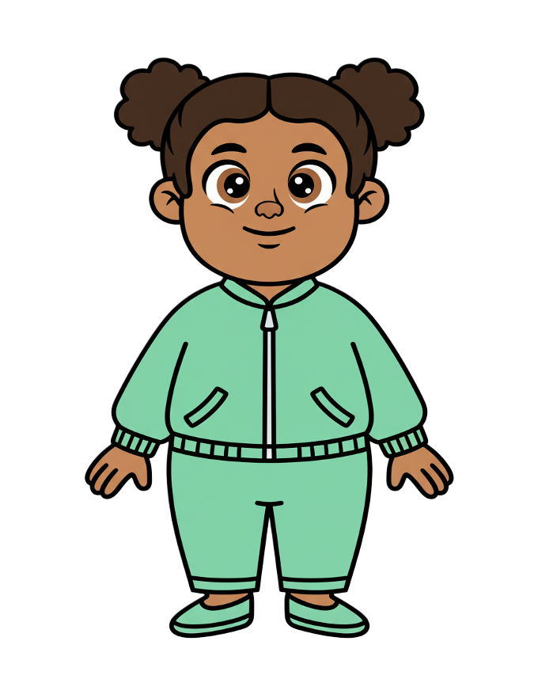
This is Zoe.

Slide 2

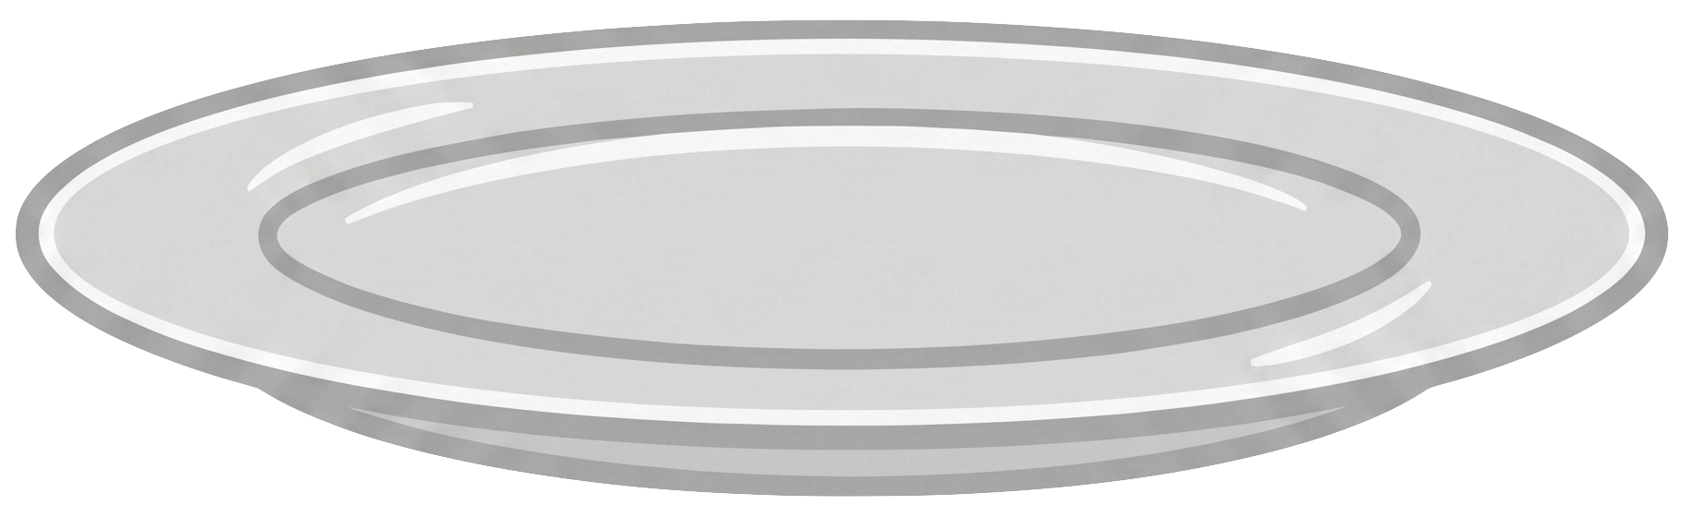
Zoe has 7 cookies.

Slide 3
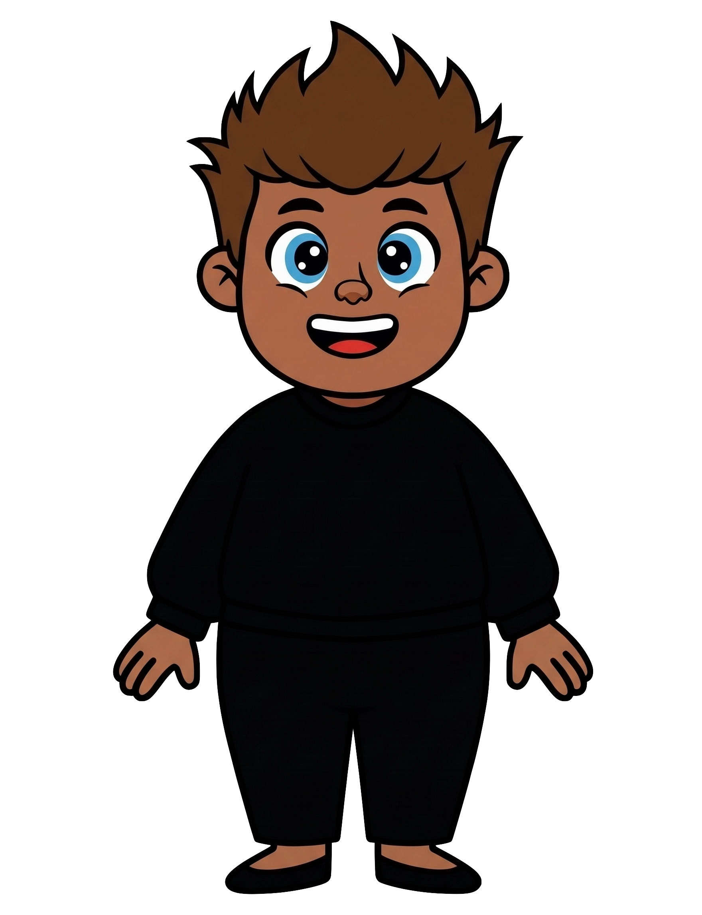
This is Rex.

Slide 4
Rex has 7 cookies.

Slide 5
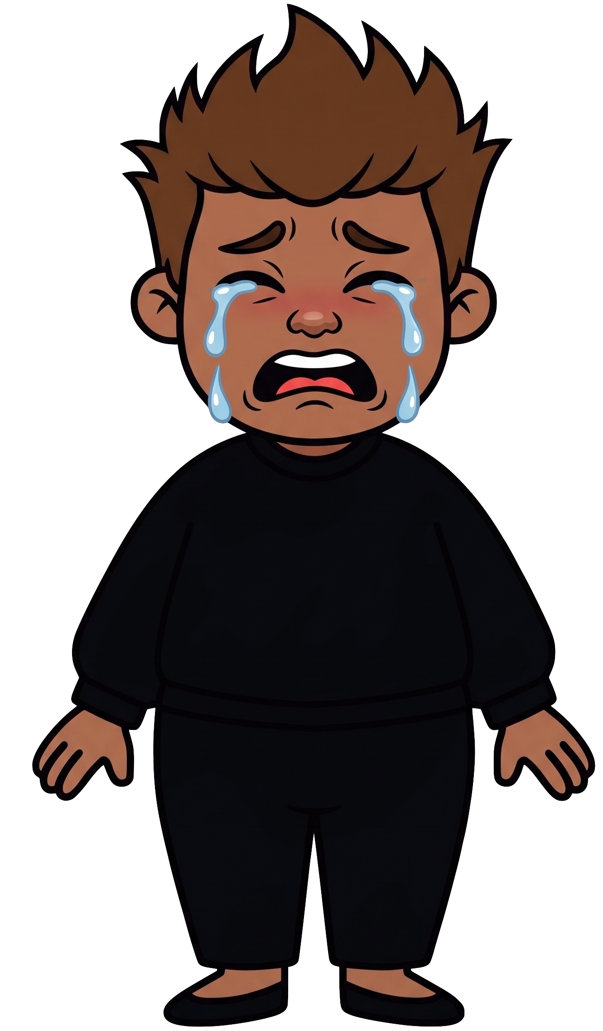
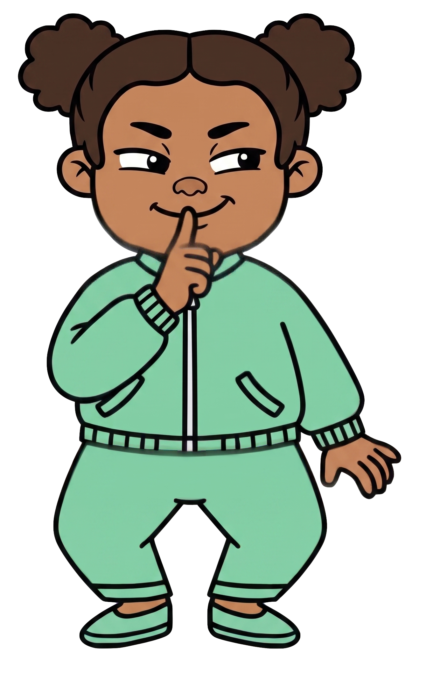
Zoe wants Rex to have fewer cookies.

Slide 6
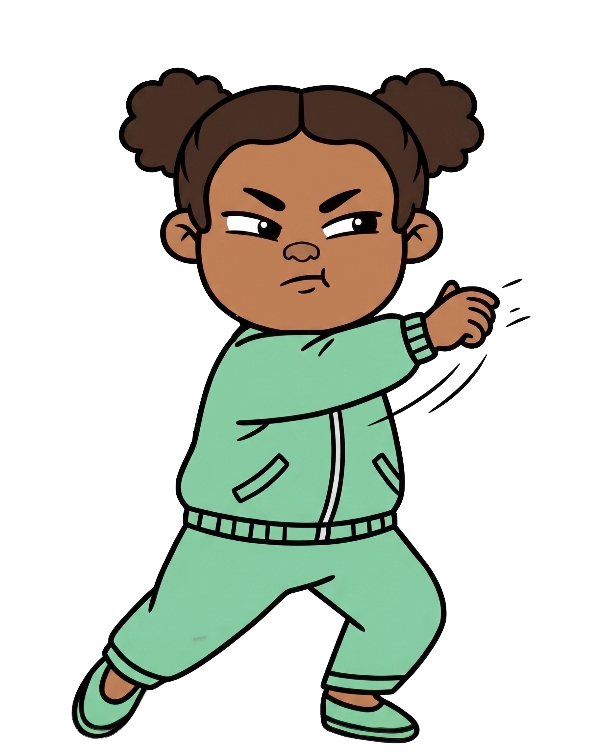
Oh no! Zoe throws 2 of Rex’s cookies!

Slide 7
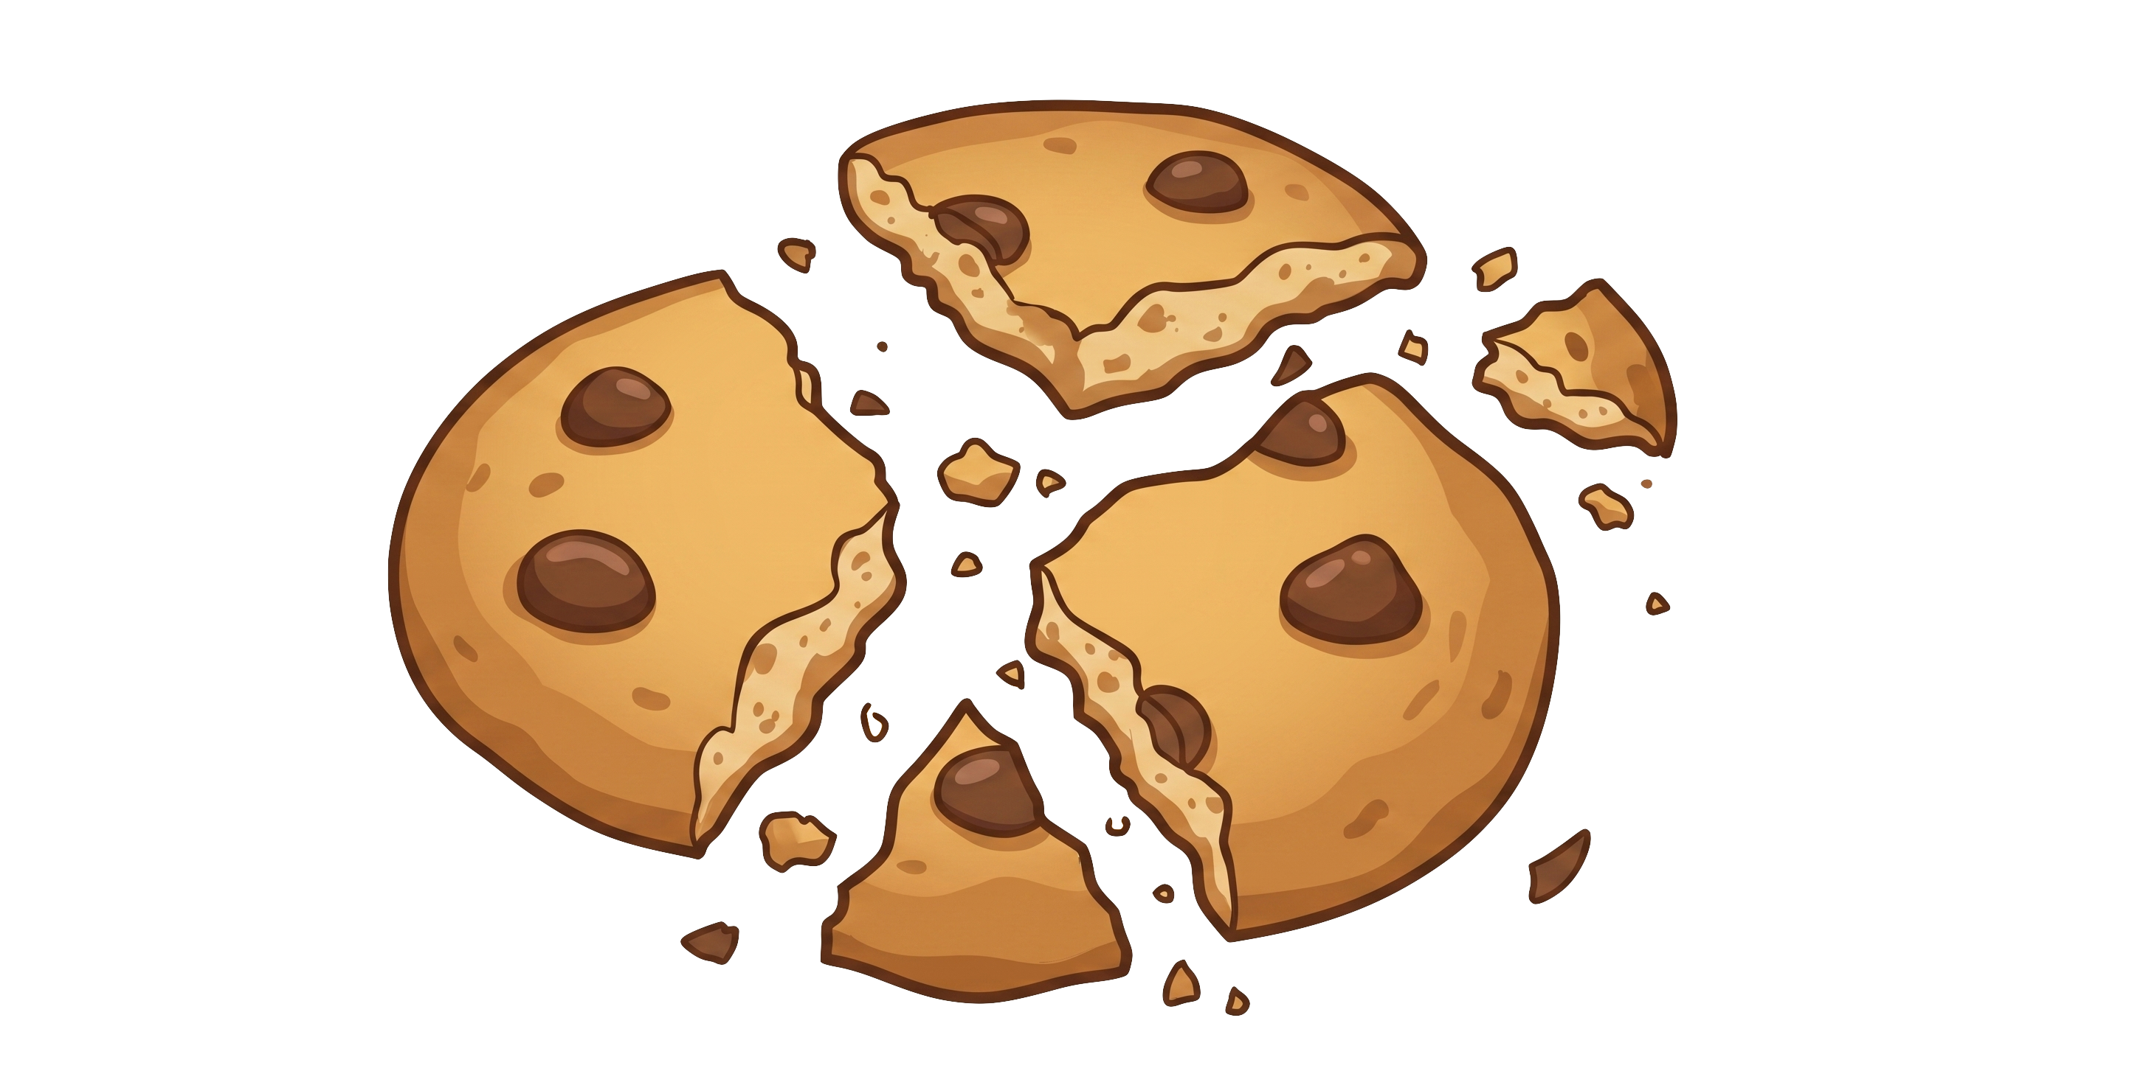
Zoe still has 7 cookies. Rex now has 5 cookies.

